Slide 1
Angular – dag 2 Korte herhaling
Peter Eijgermans – peter.eijgermans@ordina.nl

Slide 2


Angular
Components
Data binding
Services
TypeScript
Routing
Classes
Form
Event binding
Observables
Templates Pipes Views
…

Slide 3
TypeScript
ES6
ES5

Slide 4
Component based A component adds logic to DOM elements
main.ts
AppModule
AppComponent
app.component.html
BookSearchComponent
DashBoardComponent
BooksComponent
BookDetalsComponent

Slide 5
Flow single page app
index.html
AppComponent
app.component.html
BookSearchComponent
DashBoardComponent
BooksComponent
BookDetalsComponent
Notes:
Angular is a tree of components, because it has the same structure as your html-structure !!!
Index.html is the parent template of AppComponent ect…
AppComponent is the parent of BookComponent and …
main.ts

Slide 6
Data binding
Nieuwe notatiewijzen in HTML-views/partials.
Simple data binding {{ … }}
Event binding (…)=“...”
One-way data binding […]=“...”
Two-way data binding [(ngModel)]
= “ …”

Slide 7
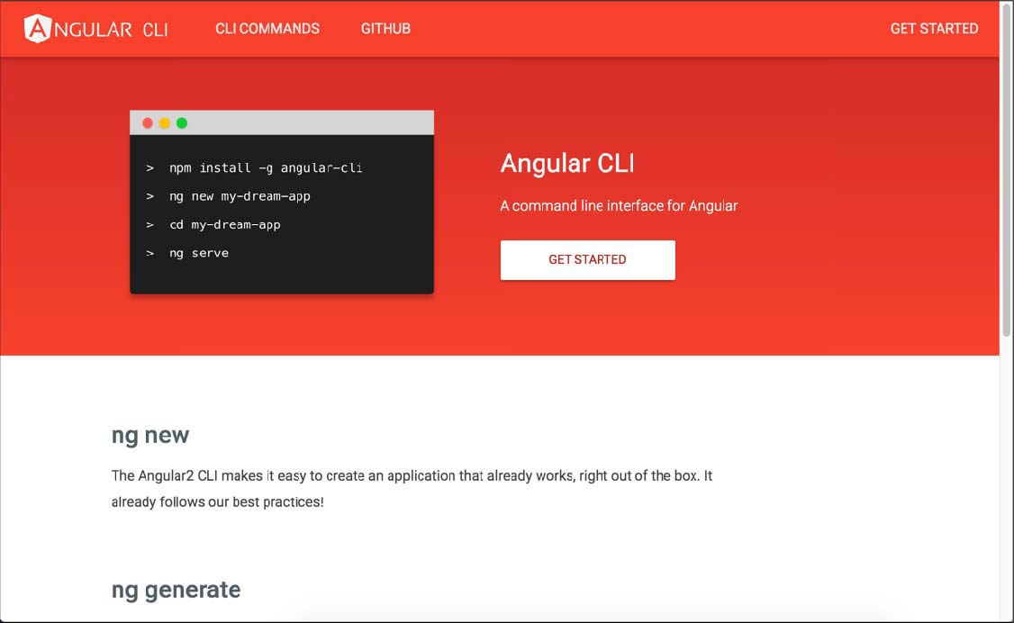
Angular CLI

Slide 8
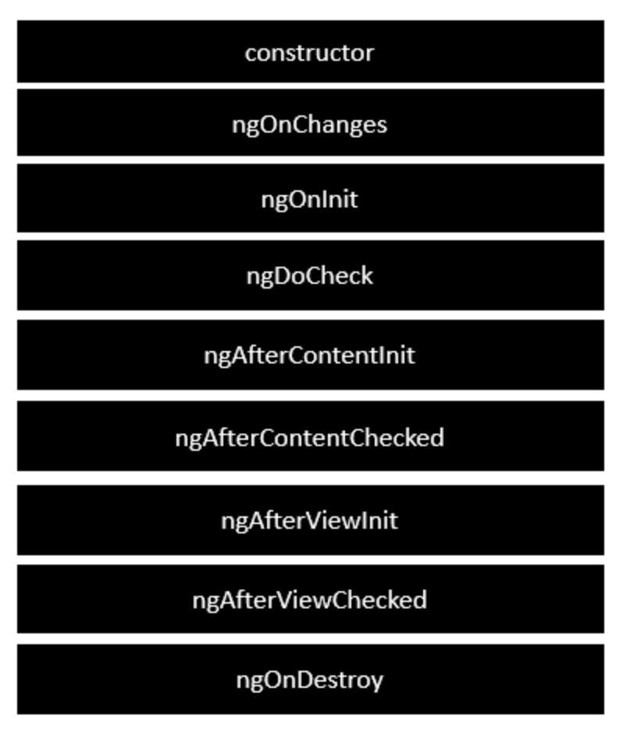
Life Cycle Hooks
https://angular.io/guide/lifecycle-hooks#lifecycle-examples
Notes:
Following is a description of each lifecycle hook.
ngOnChanges − When the value of a data bound property changes, then this method is called.
ngOnInit − This is called whenever the initialization of the directive/component after Angular first displays the data-bound properties happens.
ngDoCheck − This is for the detection and to act on changes that Angular can't or won't detect on its own.
ngAfterContentInit − This is called in response after Angular projects external content into the component's view.
ngAfterContentChecked − This is called in response after Angular checks the content projected into the component.
ngAfterViewInit − This is called in response after Angular initializes the component's views and child views.
ngAfterViewChecked − This is called in response after Angular checks the component's views and child views.
ngOnDestroy − This is the cleanup phase just before Angular destroys the directive/component.

Slide 9
Angular Constructor vs ngOnInit
https://www.linkedin.com/pulse/angular-constructor-vs-ngoninit-madhumati-hosamani/

Slide 10
Services
Services
Static services
Observables / rxJS
GET-ing data

Slide 11
Waarom een Service?
gegevens centraal veilig stellen
gegevens bereikbaar voor andere componenten
gegevens gaan niet verloren als je van component/view wisselt
(Component is vluchtig !)

Slide 12
Data flow
View
{{…}}
Class / Component
Service
Uiteindelijk: veilig stellen in database via Ajax, met Http
API → Database

Slide 13
Observables
Notes:
You are a Observer = Listener and Subscriber on the data
TV is the Observable = Provider of Async data

Slide 14
Observable
Returns a stream of values over time

Slide 15
Vandaag
Game Observables
Vervolg Observables
Pipe async
Tree of components
Applicaties opbouwen met meerdere componenten
Data flow tussen de componenten
Routing
App maken

Slide 16
Architecture Angular project
https://medium.com/@tomastrajan/6-best-practices-pro-tips-for-angular-cli-better-developer-experience-7b328bc9db81
Notes:
A good guideline to follow is to split our application into at least three different modules — Core, Shared and Feature

